Slide 1
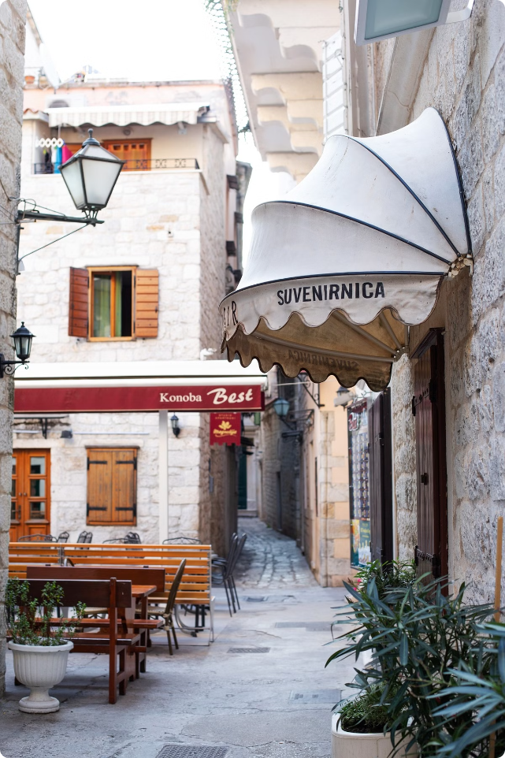
Introduction to Croatian Cuisine
Croatian cuisine is a delicious blend of Mediterranean and Central European influences. It's known for its fresh ingredients, flavorful dishes, and regional specialties.

Slide 2
Historical Influences on Croatian Cooking
1
Ancient Romans
The Romans introduced olive oil, wine, and the cultivation of grapes, which remain integral to Croatian cuisine.
2
Ottoman Empire
Turkish rule brought spices like paprika, saffron, and cinnamon, adding a unique flavor profile to Croatian dishes.
3
Austro-Hungarian Empire
Austrian and Hungarian culinary influences are evident in pastries, meats, and rich sauces.
4
Modern Croatian Cuisine
Croatian cuisine continues to evolve while preserving its rich culinary heritage.

Slide 3
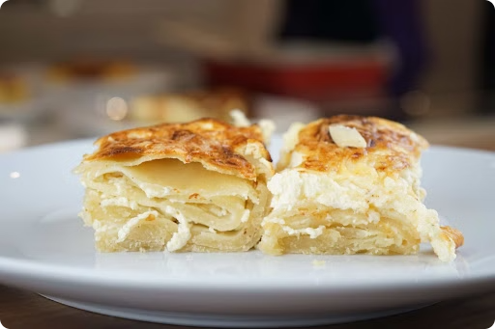
Typical Croatian Dishes and Their Origins
Pasticada
Peka
A slow-cooked beef stew with prosciutto, wine, and vegetables, originating from Dalmatia.
A dish cooked under a bell-shaped lid, often featuring lamb, vegetables, or seafood, found throughout Croatia.
Zagorski Štrukli
Brudet
A savory dish of dough filled with cheese, originating from Zagorje, a region in northern Croatia.
A hearty seafood stew, often made with fish, shellfish, and vegetables, found on the Adriatic coast.

Slide 4
Seafood Specialties of the Adriatic Coast
Fresh Fish
Shellfish
Seafood Dishes
The Adriatic Sea is renowned for its abundance of fresh fish, including tuna, swordfish, and Adriatic Sea bass.
Croatia's coastline is home to a variety of shellfish, such as mussels, clams, and oysters.
Popular seafood dishes include grilled fish, seafood pasta, and fish stews like brudet.

Slide 5
Meat-Based Dishes from the Inland Regions
1
Roasted Lamb
2
Pork
Lamb is a popular meat in inland Croatia, often roasted whole and seasoned with herbs and spices.
Pork is another common meat in Croatian cuisine, used in dishes like ćevapčići (grilled sausages) and sarma (stuffed cabbage rolls).
3
Beef
4
Game
Beef is also popular, particularly in stews like pasticada and goulash.
Wild boar, venison, and pheasant are also found in some regional dishes.

Slide 6
Vegetable and Dairy Products in Croatian Cuisine
Vegetables
Dairy Products
Tomatoes, peppers, onions, garlic, and zucchini are widely used in Croatian cuisine.
Cheese, yogurt, and sour cream are common ingredients in soups, stews, and sauces.
Croatian cuisine also features potatoes, cabbage, and beans in various dishes.
Sheep's milk cheese, particularly the traditional Pag cheese, is a specialty of the island of Pag.

Slide 7
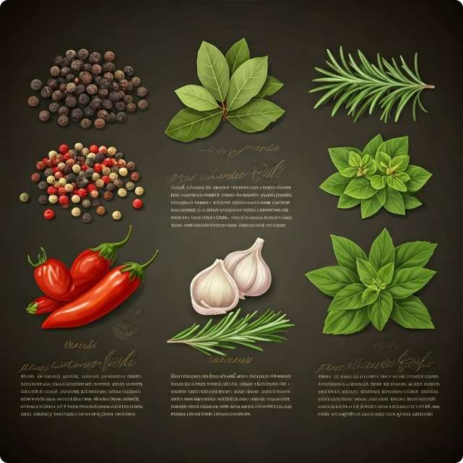
Unique Spices and Herbs Used in Croatian Cooking
Black Pepper
Bay Leaf
A staple spice used to add a kick to various dishes.
Used in stews, soups, and marinades to add a savory aroma.
Rosemary
Oregano
A fragrant herb used to flavor meats, vegetables, and sauces.
A flavorful herb used in dishes like pasta sauces and grilled vegetables.

Slide 8
The Role of Bread and Baked Goods
Traditional Breads
Croatia has a long tradition of baking bread, with various regional varieties.
Freshly Baked Bread
Fresh bread is a staple food in Croatia, often served with meals and used for sandwiches.
Pastries
Croatian cuisine also features a variety of pastries, including strudels, cakes, and cookies.

Slide 9
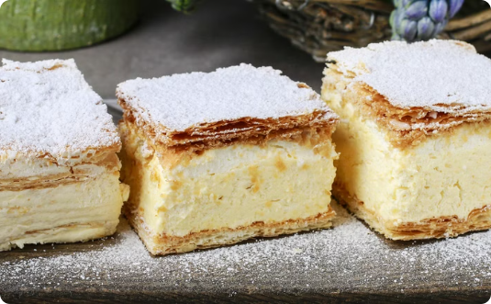
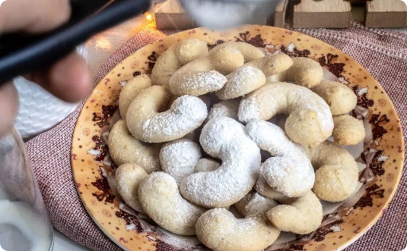
Traditional Croatian Desserts and Sweets
Kremšnita
Orehnjača
Vanilija Kolačići
A layered custard cake, often served with whipped cream or fruit.
A walnut cake, a popular dessert in Croatia and other parts of the Balkans.
Vanilla cookies, a simple but classic Croatian sweet treat.

Slide 10
Conclusion: The Diversity and Richness of Croatian Cuisine
Croatian cuisine is a testament to the country's rich history and diverse culinary influences. It offers a tantalizing journey for food lovers, with its flavorful dishes and fresh ingredients.

